Slide 1
ONLINE CLASS
GRAPH THEORY
BICTE $6^{TH}$ SEMESTER
2078/03/22
PRESENTED BY KALYAN DAHAL

Slide 2
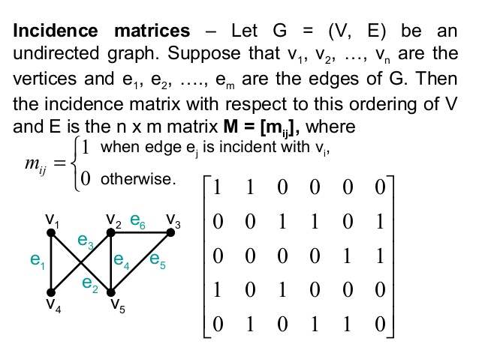

Slide 3
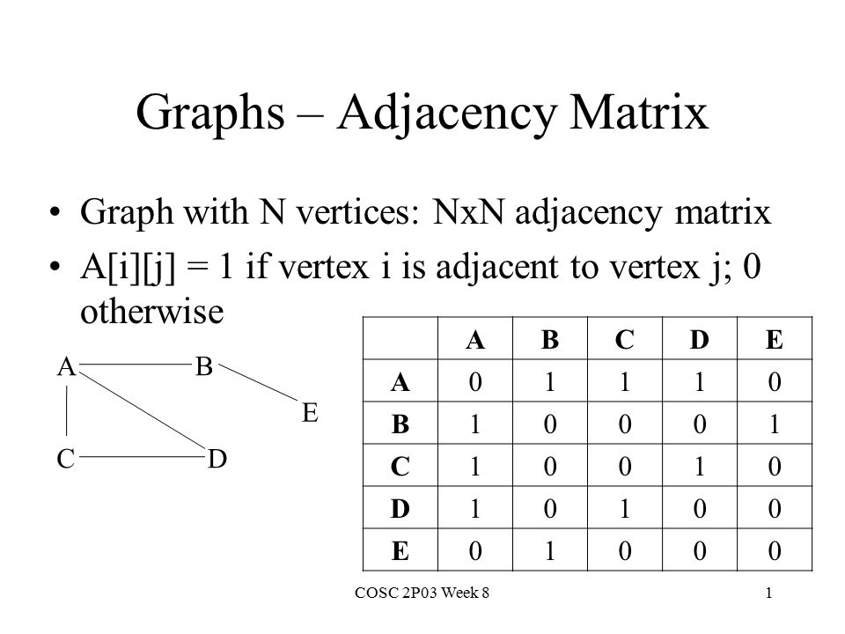

Slide 4
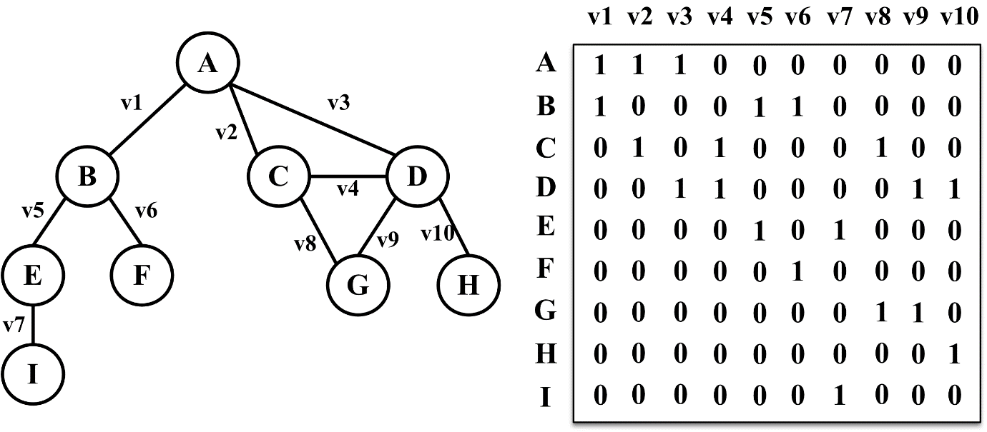
1. Construct an incidence matrix.

Slide 5
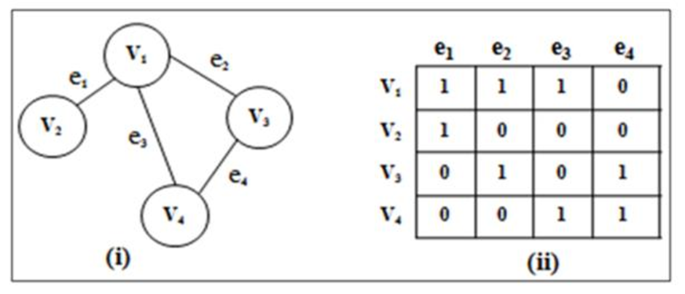
2. Construct an incidence matrix.

Slide 6
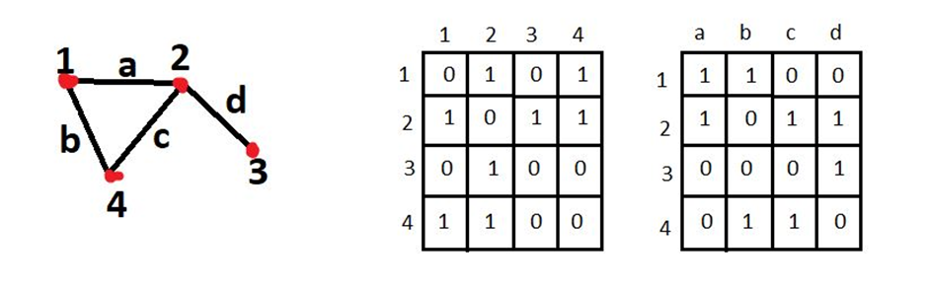
3. Construct an incidence and adjacency matrix.

Slide 7
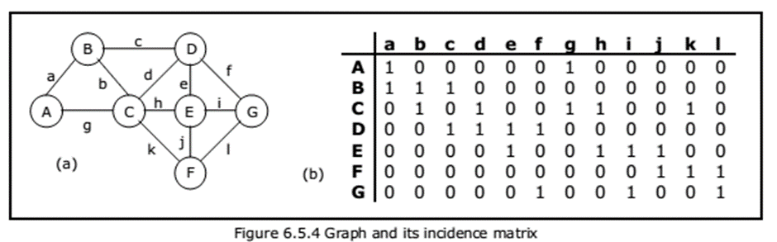
4. Construct an incidence matrix.

Slide 8
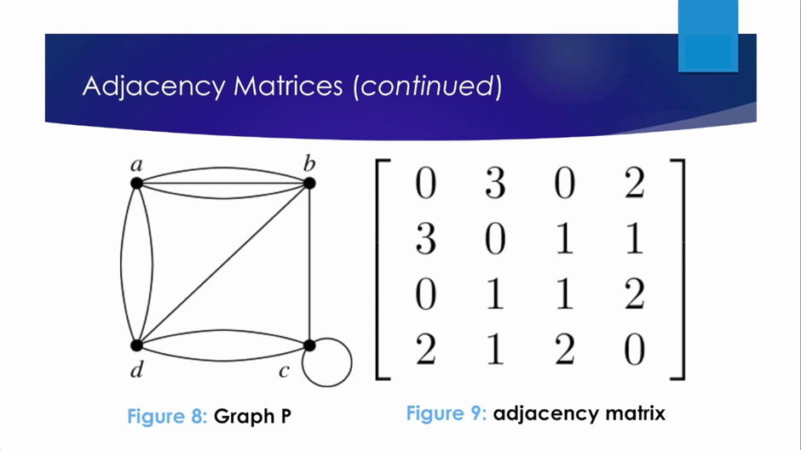
5. Construct an adjacency matrix.

Slide 9
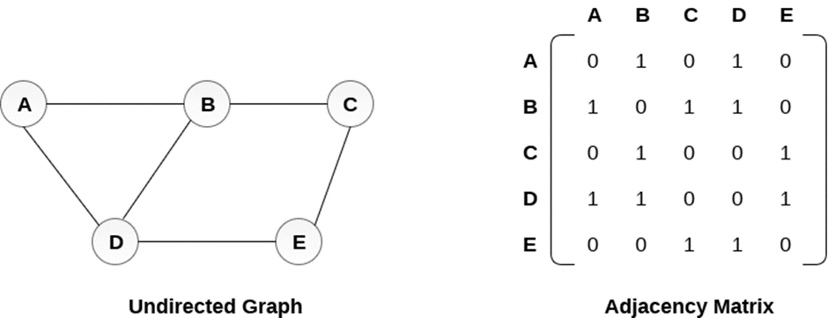
6. Construct an adjacency matrix.

Slide 10
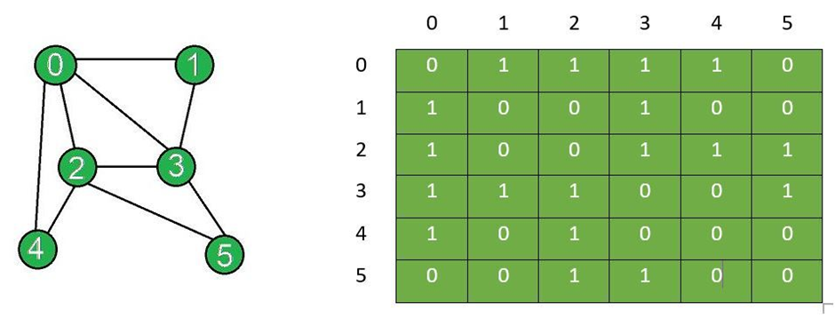
7. Construct an adjacency matrix.

Slide 11
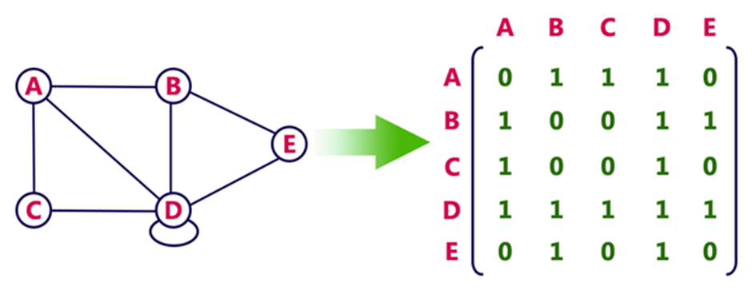
8. Construct an adjacency matrix.

Slide 12
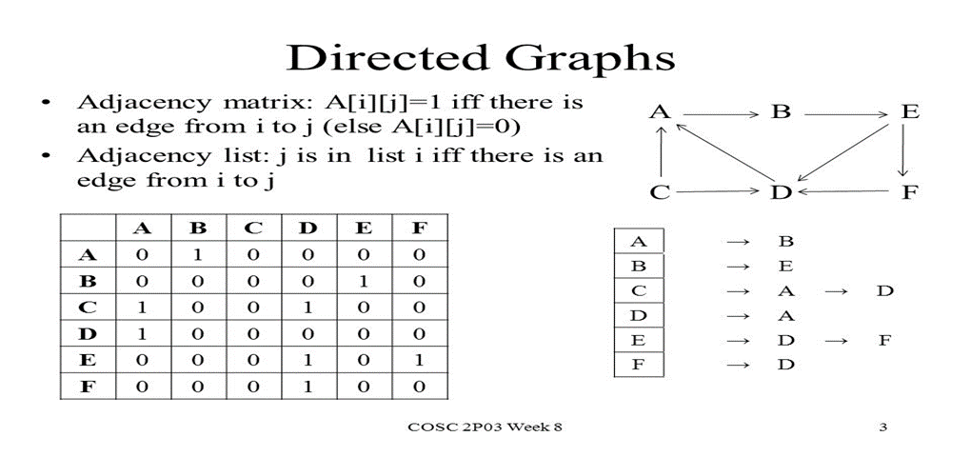
Adjacency matrix of a digraph

Slide 13
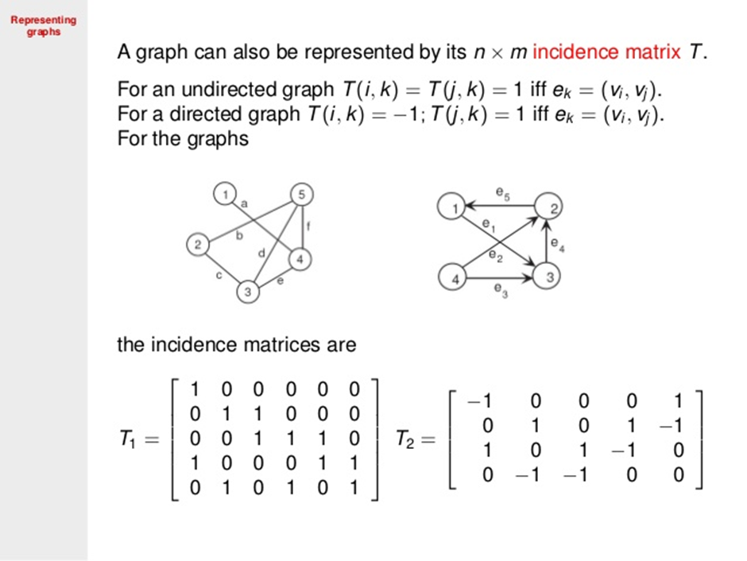
Incidence matrix of a digraph:

Slide 14
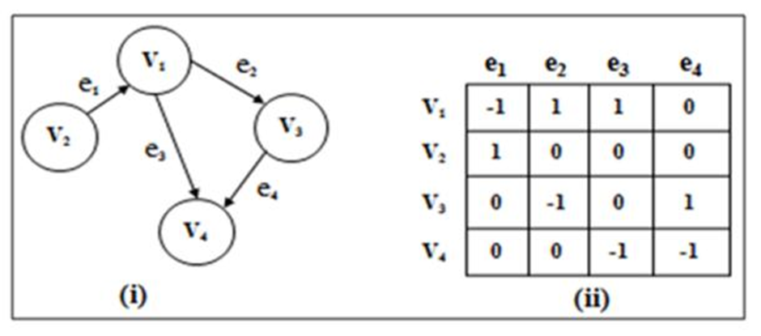
9. Construct an incidence matrix.

Slide 15
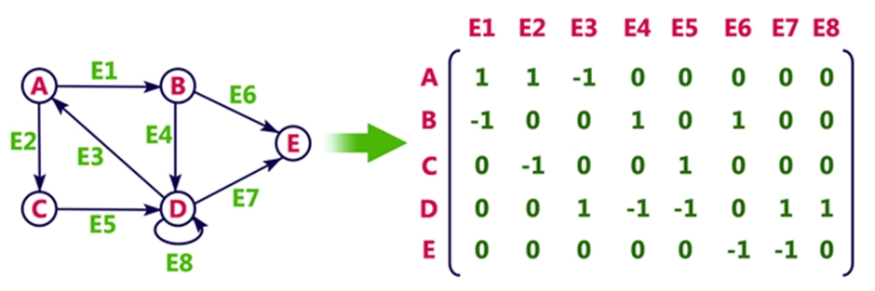
10. Construct an incidence matrix.

Slide 16
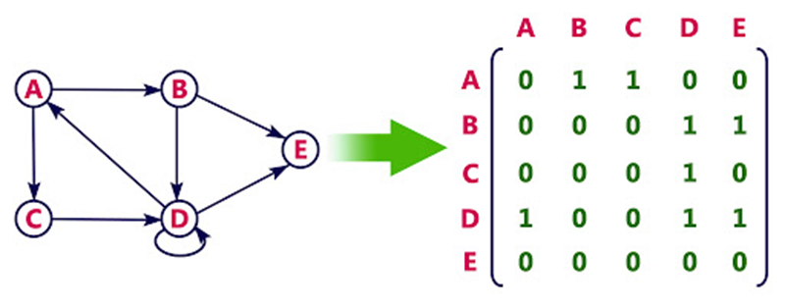
11. Construct an adjacency matrix.

Slide 17
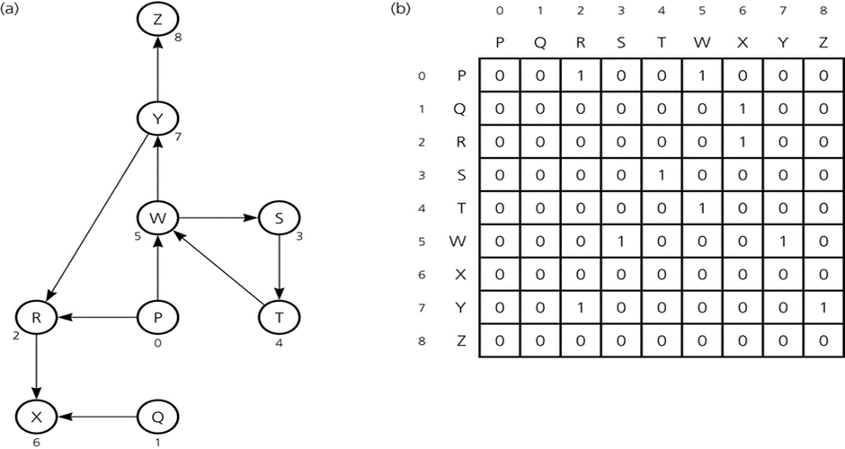
12. Construct an adjacency matrix.

Slide 18
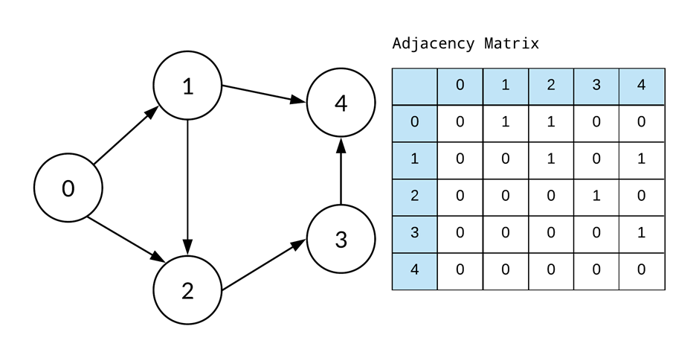
13. Construct an adjacency matrix.

Slide 19


